Slide 1
The ADT Stack
Notes:
This video describes the ADT stack and provides several examples of its use.

Slide 2
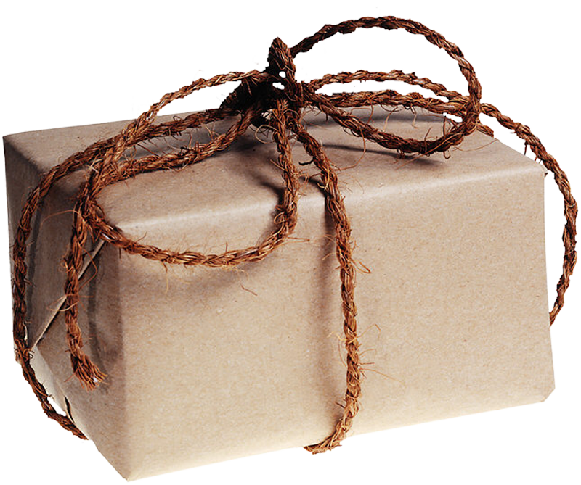

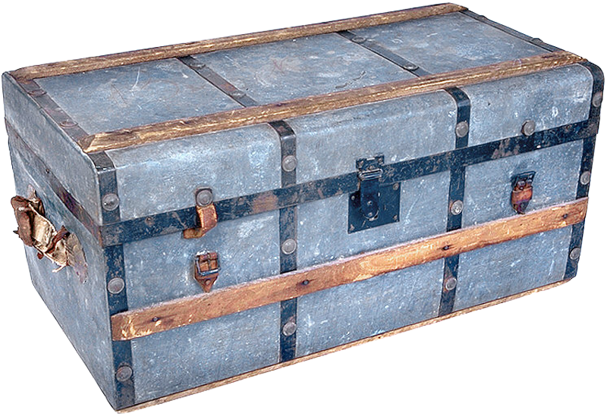
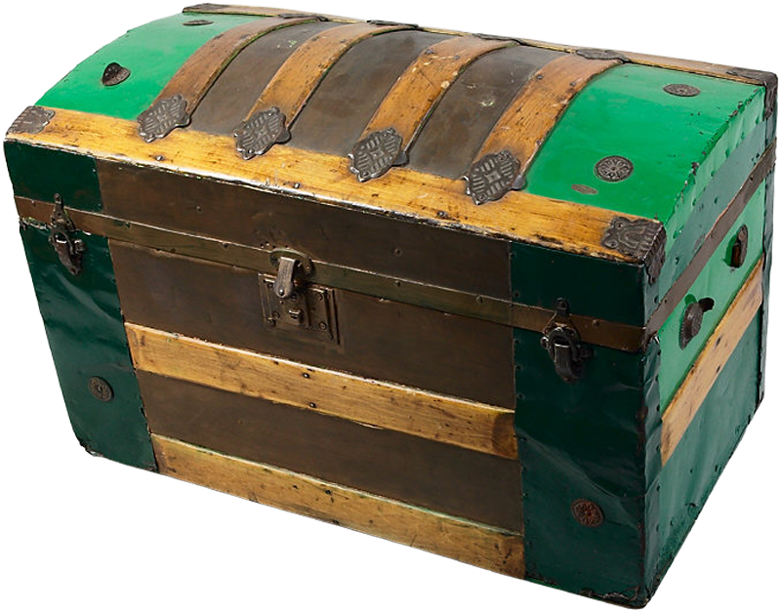


The Stack Concept
Stack Characteristics
Last-in, first-out (LIFO) property
Last item placed on stack will be first item removed
Items placed and removed on top of stack
Some Real Life Stacks
Books on a desk
Dishes in a Cafeteria
Boxes in an attic
push( )
pop()
top
Notes:
This video describes the ADT stack and provides several examples of its use.
In everyday life, a stack is a familiar thing. You might see a stack of books on your desk, a stack of dishes in the cafeteria, a stack of towels in the linen closet, or a stack of boxes in the attic. When you add an item to a stack, you place it on top of the stack. When you remove an item, you take the topmost one. This topmost item is the last one that was added to the stack. So when you remove an item, you remove the item added most recently. That is, the last item added to the stack is the first one removed.
In spite of our examples of a stack, everyday life usually does not follow this last-in, first-out, or LIFO, behavior. Although the employee hired most recently is often the first one fired during a layoff, we live in a first-come, first-served society. In the computer science world, however, last-in, first-out is exactly the behavior required by many important algorithms. These algorithms often use the abstract data type stack, which is an ADT that exhibits a last-in, first-out behavior. For example, a compiler uses a stack to interpret the meaning of an algebraic expression, and a run-time environment uses a stack when executing a recursive method.
@@ The ADT stack organizes its entries according to the order in which they were added. All additions are to one end of the stack called the top. The top entry— that is, the entry at the top— is thus the newest item among the items currently in a stack.
The stack restricts access to its entries. A client can look at or remove only the top entry.
@@ The only way to look at an entry that is not at the top of the stack is to repeatedly remove items from the stack until the desired item reaches the top. If you were to remove all of a stack’s entries, one by one, you would get them in reverse chronological order, beginning with the most recent and ending with the first item added to the stack.

Slide 3
The ADT Stack
Collection of objects in reverse chronological order with same data type
ADT Stack operations
Add a new item to the stack
push(ItemType someItem)
Remove item that was added most recently
pop()
Retrieve item that was added most recently
ItemType peek()
Determine whether a stack is empty
boolean isEmpty()
Remove all entries from the stack.
void clear()
peek()
pop()
push( )
Stack
+push(someItem: T): void
+pop(): void
+peek(): T
+isEmpty(): boolean
+clear(): void
Notes:
Let's look at the specifications of the ADT Stack - A stack is a collection of objects in reverse chronological order and having the same data type
@@ The method PUSH adds new items at the top of the stack. Push has one parameter - the entry we are adding to the stack. After each call to push, the stack should have one additional item
@@ The method pop removes the item that is currently on top of the stack and returns it to the user. After calling pop, the stack has one less item than it did before the call.
@@ The method peek retrieves the item most recently added to the stack. This differs from the method pop in that the item is not removed, but remains on the stack - so the stack is unchanged by a peek.
@@ isEmtpy checks to see if the stack is empty and returns true if it is
@@ The method clear removes all items form the stack without returning them to the client.
@@ From these specifications and the UML, we can develop a C++ abstract base class, StackInterface using the template type ItemType to represent the type of data stored in the stack

Slide 4
The ADT Stack
/** @file StackInterface.h */
#ifndef STACKINTERFACE
#define STACKINTERFACE
template<class ItemType>
class StackInterface
{
public:
virtual bool isEmpty() const = 0;
virtual bool push(const ItemType& someItem) = 0;
virtual bool pop() = 0;
virtual ItemType peek() const = 0;
virtual ~StackInterface() { }
}; // end StackInterface
#endif
Stack
+push(someItem: T): void
+pop(): void
+peek(): T
+isEmpty(): boolean
+clear(): void
Notes:
Let's look at the specifications of the ADT Stack - A stack is a collection of objects in reverse chronological order and having the same data type
@@ The method PUSH adds new items at the top of the stack. Push has one parameter - the entry we are adding to the stack. After each call to push, the stack should have one additional item
@@ The method pop removes the item that is currently on top of the stack and returns it to the user. After calling pop, the stack has one less item than it did before the call.
@@ The method peek retrieves the item most recently added to the stack. This differs from the method pop in that the item is not removed, but remains on the stack - so the stack is unchanged by a peek.
@@ isEmtpy checks to see if the stack is empty and returns true if it is
@@ The method clear removes all items form the stack without returning them to the client.
@@ From these specifications and the UML, we can develop a C++ abstract base class, StackInterface using the template type ItemType to represent the type of data stored in the stack

Slide 5
Using the ADT Stack
template<class ItemType>
class StackInterface {
public:
virtual bool isEmpty() const = 0;
virtual bool push(const ItemType& someItem) = 0;
virtual bool pop() = 0;
virtual ItemType peek() const = 0;
virtual ~StackInterface() { }
}; // end StackInterface
/** @file StackInterface.h */
#ifndef STACKINTERFACE
#define STACKINTERFACE
template<class ItemType>
class StackInterface
{
public:
virtual bool isEmpty() const = 0;
virtual bool push(const ItemType& someItem) = 0;
virtual bool pop() = 0;
virtual ItemType peek() const = 0;
virtual ~StackInterface() { }
}; // end StackInterface
#endif
Notes:
To save some space, I'm going to remove the comments from our interface listing.
@@ Here is a short code snippet that creates an empty stack to hold String objects. It adds several items to the stack, and then retrieves and removes two of them.
@@ We begin by creating the an instance of a Stack implementation to hold our collection of Strings.
@@ Five names are pushed on to the stack. The first name pushed onto the stack is at the bottom. If our client would like to access "Jim", each of the names above him would need to be removed (or popped) from the stack before Jim could be accessed.
@@ The string at the top of the stack is Joe; the peek retrieves a copy of it. So our print statement displays the message Joe is at the top of the stack.
@@ By calling pop, we remove Joe from the stack.
@@ A subsequent call to peek retrieves Jane.
@@ Then pop removes Jane from the stack
Three more calls to pop would remove Jill, Jess, and Jim, leaving the stack empty. After that, A subsequent call to either pop or peek would return null.

Slide 6

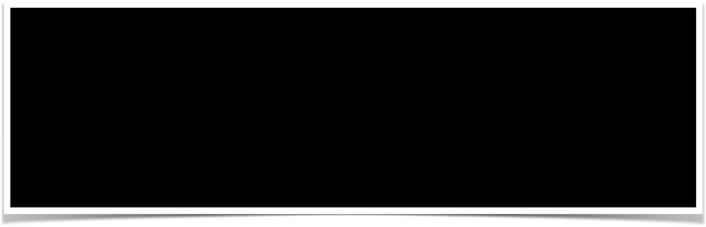
Using the ADT Stack
template<class ItemType>
class StackInterface {
public:
virtual bool isEmpty() const = 0;
virtual bool push(const ItemType& someItem) = 0;
virtual bool pop() = 0;
virtual ItemType peek() const = 0;
virtual ~StackInterface() { }
}; // end StackInterface
Jokha
Stack<std::string>* stringStack = new Stack<std::string>();
stringStack->push("Jeet"); stringStack->push("Juan"); stringStack->push("Jachin"); stringStack->push("Jane");
stringStack->push("Jokha");
std::string top = stringStack->peek();
std::cout << top << " is at the top of the stack.\n";
if (stringStack->pop())
std::cout << top << " is removed from the stack.\n";
top = stringStack>peek();
std::cout << top << " is at the top of the stack.\n";
if (stringStack->pop())
std::cout << top << " is removed from the stack.\n";
Jokha
Jane
Jane
Jachin
Juan
Jeet
Jokha is at the top of the stack.
Jokha is removed from the stack.
Jane is at the top of the stack.
Jane is removed from the stack.
Notes:
To save some space, I'm going to remove the comments from our interface listing.
@@ Here is a short code snippet that creates an empty stack to hold String objects. It adds several items to the stack, and then retrieves and removes two of them.
@@ We begin by creating the an instance of a Stack implementation to hold our collection of Strings.
@@ Five names are pushed on to the stack. The first name pushed onto the stack is at the bottom. If our client would like to access "Jim", each of the names above him would need to be removed (or popped) from the stack before Jim could be accessed.
@@ The string at the top of the stack is Joe; the peek retrieves a copy of it. So our print statement displays the message Joe is at the top of the stack.
@@ By calling pop, we remove Joe from the stack.
@@ A subsequent call to peek retrieves Jane.
@@ Then pop removes Jane from the stack
Three more calls to pop would remove Jill, Jess, and Jim, leaving the stack empty. After that, A subsequent call to either pop or peek would return null.

Slide 7
Balanced Expressions
Notes:
This video describes the ADT stack and provides several examples of its use.

Slide 8

Balanced Expressions
Checking for Balanced Expressions
Scan expression:
Ignore characters that are not delimiters
When open delimiter is encountered
push it on the stack
When close delimiter is encountered
check to see if it matches top of stack
if yes, pop off top of stack
if not, expression is not balanced
If braces are balanced
stack is empty when expression is done
Balanced
Not Balanced
{ [ ( ) ( ) ] ( ) }
[ ( ] )
a { b [ c ( d + e ) / 2 - f ] + 1 }
{
[
(
delimeterStack
Notes:
Although programmers use parentheses when writing arithmetic expressions in Java, mathematicians use parentheses, square brackets, and braces for the same purpose. These delimiters must be paired correctly. For example, an open parenthesis must correspond to a close parenthesis. In addition, pairs of delimiters must not intersect.
@@ Thus, an expression can contain a sequence of delimiters such as this example
@@ But not this
For convenience, we will say that a balanced expression contains delimiters that are paired correctly, or are balanced. We want an algorithm that detects whether an infix expression is balanced.
@@ Let’s see whether this expression is balanced. We scan the expression from left to right, looking for delimiters and ignoring any characters that are not delimiters.
@@ When we encounter an open delimiter, we must save it.
@@ When we find a close delimiter, we must see whether it corresponds to the most recently encountered open delimiter. If it does, we discard the open delimiter and continue scanning the expression.
@@ If we are able to scan the entire expression without a mismatch, the delimiters in the expression are balanced.
@@ The ADT that enables us to store objects and then retrieve or remove the most recent one is a stack.
@@ As we scan the expression, each time we find an open delimiter, we push it onto the stack
@@ Each time we find a closing delimiter, we peek at the top of the stack. If the delimiters match, we pop the top delimiter off the stack.
If the delimiters DO NOT match, then the expression is not balanced.
@@ In this case, we have reached the end of the expression and the stack is empty so the expression is balanced.

Slide 9

Balanced Expressions
Checking for Balanced Expressions
Scan expression:
Ignore characters that are not delimiters
When open delimiter is encountered
push it on the stack
When close delimiter is encountered
check to see if it matches top of stack
if yes, pop off top of stack
if not, expression is not balanced
If braces are balanced
stack is empty when expression is done
Balanced
Not Balanced
{ [ ( ) ( ) ] ( ) }
[ ( ] )
a { b [ c ( d + e ] / 2 - f ) + 1 }
{
[
(
Notes:
Let's examine an expression that is not balanced and see how our algorithm performs.
@@ We begin scanning as an our previous example, pushing each open delimiter onto the stack
@@ When we find a closing delimiter, we peek at the top of the stack, it does not match the stack top so we can stop here - the expression is not balanced.
This algorithm also identifies expressions that are not balanced because they have extra, or unmatched open parenthesis. In those expressions, the stack would not be empty after scanning the string. The extra open delimiters would remain on the stack.

Slide 10
Check Balance
Implementation
bool checkBalance(string expression) {
Stack<char> openDelimiterStack = new Stack<char>();
int characterCount = expression.length();
bool isBalanced = true;
int index = 0;
char nextCharacter = ' ';
while (isBalanced && (index < characterCount)) {
nextCharacter = expression.charAt(index);
switch (nextCharacter){
case '(': case '[': case '{':
openDelimiterStack->push(nextCharacter);
break;
case ')': case ']': case '}':
if (openDelimiterStack->isEmpty())
isBalanced = false;
else
{ char openDelimiter = openDelimiterStack->peek();
openDelimiterStack->pop();
isBalanced = isPaired(openDelimiter, nextCharacter);
} // end if
break;
default:
break;
} // end switch
index++;
} // end while
if (!openDelimiterStack->isEmpty())
isBalanced = false;
return isBalanced;
} // end checkBalance
// Returns true if the given characters, open and close,
//form a pair of parentheses, brackets, or braces.
bool isPaired(char open, char close) {
return (open == '(' && close == ')') ||
(open == '[' && close == ']') ||
(open == '{' && close == '}');
} // end isPaired
Notes:
LEt's put together a short implementation of our balance checker algorithm using a stack.
First we can write a short helper method that can validate whether or not delimiters are matching. This short method, isPaired, compares its two parameters, expecting the first to be an open delimiter and the second to be a closing delimiter. It then returns the result of or'ing together several pair tests. If one of these tests are true, the the delimiters match.
@@ The method to implement our algorithm is the checkBalance method. The expression we are going to check is passed as the parameter - expression.
We begin by creating our stack - openDelimiterStack and initializing several important variables, among these are isBalanced which we use to hold the state of the expression. We can initialize it to true because at this point, no delimiters have been processed so the expression is balanced.
@@ Then we implement our algorithm inside the checkBalance method. We scan the expression as long as it is balanced and there are additional unscanned characters.
@@ With each character, we use a switch statement to check if
@@ it is an open delimiter. If so, we push it on our stack.
@@ if it is a close delimiter, and the stack is empty, the expression is not balanced since there should have been a matching open delimiter on the stack.
@@ otherwise, we pop off the top delimiter from the stack and call the isPaired help method to see if it matches the current delimiter from the expression. We set isBalanced to the boolean that is returned from this test. If the test fails, isBalanced is false and we end the while loop scan.
@@ if the character is not a delimitier, we do the default switch which is nothing. After the switch, we increment index so that we examine the next character and repeat the loop.
@@ Once the expression has been scanned, if there are still delimiters in the stack, the expression is not balanced. If the stack is empty, then either is is balanced because we scanned the entire expression or it was found unbalanaced since a closed delimiter was found when the stack was empty. In either case, isBalanced has already been correctly set so we can just return isBalanced and end the method.

Slide 11
Algebraic Expressions

Slide 12


Algebraic Expressions
Operator Precedence
( ) Parenthesis
- + Unary
^ Exponentiation
* / % Multiplicative
+ - Additive
Binary Operators
Require two operands
4 + 5
Unary Operators
Single operand
-6
Infix
Common Notation
5 + 6
5 + 6 * 7
(5 + 6) * 7
20 - 2 * 2 ^ 3
20 - 2 * 8
20 - 16
4
5
+
6
*
7
Prefix
Functional Languages
+ 5 6
+ * 7 6 5
* + 5 6 7
5
+
6
*
7
Postfix
Reverse Polish Notation
5 6 +
5 6 7 * +
7 5 6 + *
operatorStack
Notes:
In mathematics, an algebraic expression is composed of operands that are variables or constants and operators, such as + for addition and * for multiplication. We will use ^ to indicate exponentiation, with the warning that C++ has no operator for exponentiation;
When an algebraic expression has no parentheses, operations occur in a certain order. Exponentiations occur first; they take precedence over the other operations. Next, multiplications and divisions occur, and then additions and subtractions.
@@ For example, the expression
20 - 2 * 2 ^ 3
@@ evaluates as 20- 2* 8,
@@ then as 20- 16,
@@ and finally as 4.
@@ Operators generally have two operands, and so are called binary operators. For example, the + in 4 + 5 is a binary operator.
@@ The operators + and - can also be unary operators when they have one operand. For example, the minus sign in -6 is a unary operator.
@@ Ordinarily, we place a binary operator between its operands, as in 5 + 6. An expression in this familiar notation is called an infix expression. Other notations are possible.
@@ For example, you could write a binary operator before its two operands. Thus, 5 + 6 becomes + 5 6. This expression is called a prefix expression. Here are the three expressions shown above, but in prefix notation.
@@ You could write a binary operator after its two operands, so 5 + 6 becomes 5 6 +. This expression is a postfix expression. Although infix expressions are more familiar to us, both prefix and postfix expressions are simpler to process because they do not use precedence rules or parentheses.
The precedence of an operator in either a prefix expression or a postfix expression is implied by the order in which the operators and operands occur in the expression. THis can make them easier to evaluate so let's look at converting an infix expression to postfix form:
@@ we scan the infix expression from left to right.
@@ When we encounter an operand, we place it at the end of the new expression that we are creating. When converting, operands in an infix expression remain in the same order in the corresponding postfix expression.
@@ When we encounter an operator, we must save it until we determine where in the output expression it belongs. For example, to convert the infix expression 5 + 6, we append 5 to the initially empty output expression, save +,
@@ and append 6 to the output expression.
@@ We now need to retrieve the + and put it at the end of the output expression to get the postfix expression 5 6 +.
@@ Retrieving the operator saved most recently is easy if we have saved it in a stack.
In this example, we saved the operator until we processed its second operand.In general, we hold the operator in a stack at least until we compare its precedence with that of the next operator.
@@ To convert the expression 5 + 6 * 7,
@@ we append 5 to the output expression, push + onto a stack, and then append 6 to the output.
What we do now depends on the relative precedences of the next operator, *, and the + at the top of the stack. Since * has a greater precedence than +, 6 is not the addition’s second operand.
Instead, the addition waits for the result of the multiplication.
@@ Thus, we push * onto the stack and append 7 to the output expression.
@@ Having reached the end of the input expression, we now pop each operator from the stack and append it to the end of the out- put expression, getting the postfix expression 5 6 7 * +.

Slide 13

Evaluating Postfix Expressions
Scan characters in the Postfix Expression
When an operand is encountered,
push it onto the operandStack
When an operator is encountered,
apply it to the top two operands of the operandStack
pop the operands from the operandStack
push the result of the operation onto the operandStack
Postfix
5
4
2
+
3
^
*
6
216
1080
operandStack
Notes:
We can use a stack to help us process the postfix expression we just created.
Evaluating a postfix expression requires no rules of operator precedence, since the order of its operators and operands dictates the order of the operations. Additionally, a postfix expression contains no parentheses to complicate the evaluation.
@@ As we scan the postfix expression, we must save operands until we find the operators that apply to them.
@@ For example, to evaluate our current postfix expression, we save each operand by pushing it onto out operandStack.
@@ When we come to an operator, we pop two values from the stack to serve as operands.
@@ After evaluating the expression, we push the result back onto the stack.
@@ We then continue this simple algorithm until there are no characters remaining in the postfix expression.
At that point we have the postfix expression and have our result.

